Slide 1
Capstone Project 1: Track Genre Classification Based On Its Audio Features
Author: Henry Talasan

Slide 2
Table of Contents
Introduction
Problem Overview
Dataset
Data Exploration
In-depth Analysis and Modeling
Conclusions

Slide 3
Problem Overview
For this part of the project, I wanted to see if two different playlists have features that separates the two.
Features looked are all features or parameters given by the Spotify API
Ex: acousticness, tempo, speechiness , valence, etc.
Explored ‘Happy’ vs. ‘Sad’ themed playlists
Some questions that I will be asking are:
Are there features or parameters that can differentiate two differently 'themed' playlists?
What of similarly 'themed' playlists?

Slide 4
Data and Data Wrangling
By taking a look at differently and similarly themed playlists, we can see that it is possible to differentiate between two different playlists and playlists with the same theme have similar values.
In order to complete the objective of the project, some more questions need to be asked:
What of playlists of more questionable theme? I.e. a theme that is not easily described.
How many songs does it take to instantiate a theme?
There are features that can make a distinction between these two themes. However, that is not to say that these features would work for all themes. Is there a way to select the correct features for each theme?
More exploration and analysis of the project will hopefully answer these questions.

Slide 5
Table of Contents
Introduction
Data Exploration
Feature Exploration
PCA
In-depth Analysis and Modeling
Conclusions

Slide 6
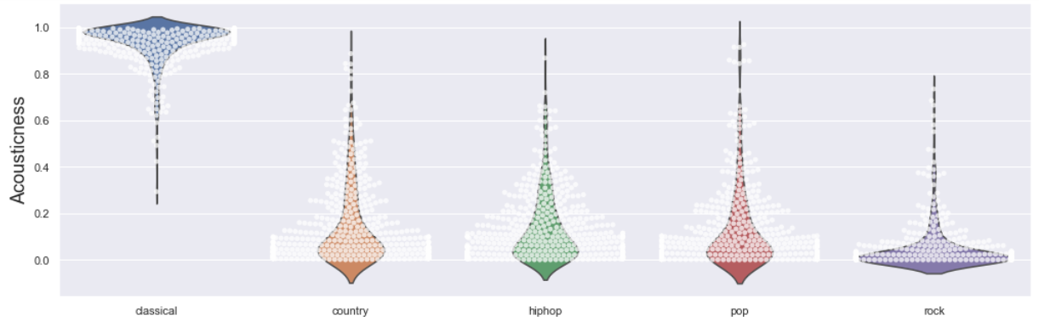
Feature Distributions based on Genre

Slide 7
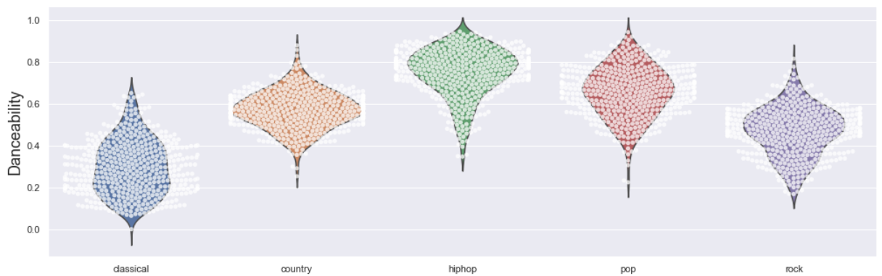
Feature Distributions based on Genre

Slide 8
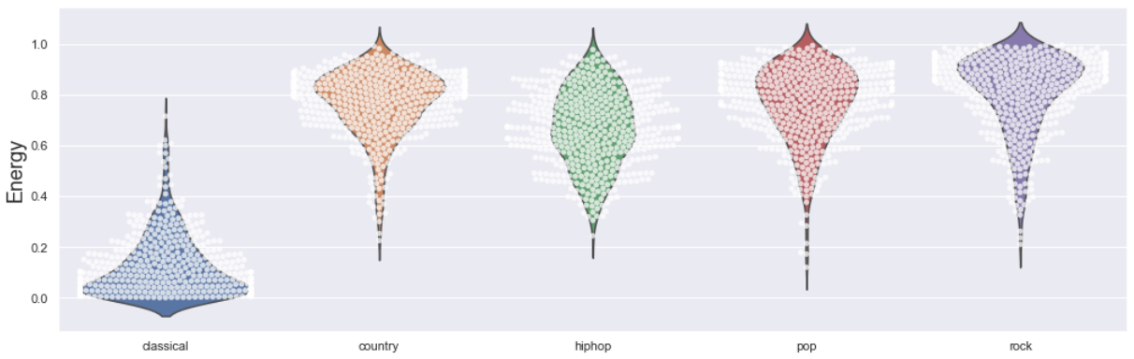
Feature Distributions based on Genre

Slide 9
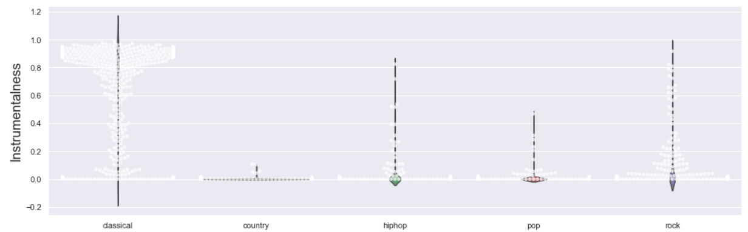
Feature Distributions based on Genre

Slide 10
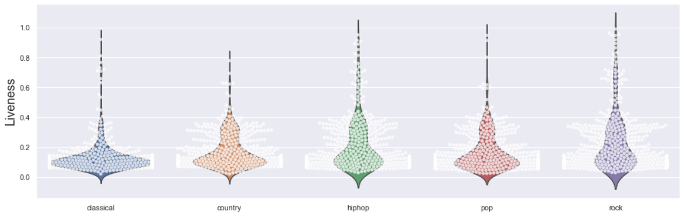
Feature Distributions based on Genre

Slide 11
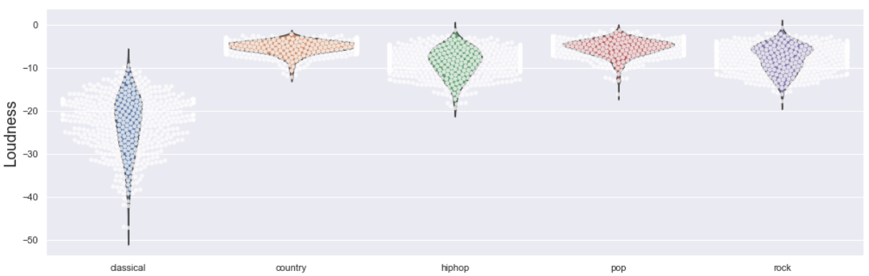
Feature Distributions based on Genre

Slide 12
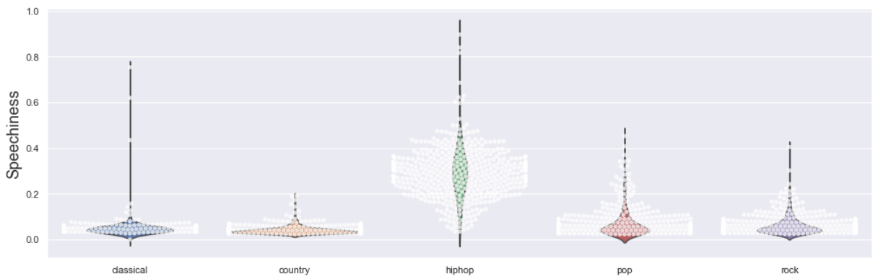
Feature Distributions based on Genre

Slide 13
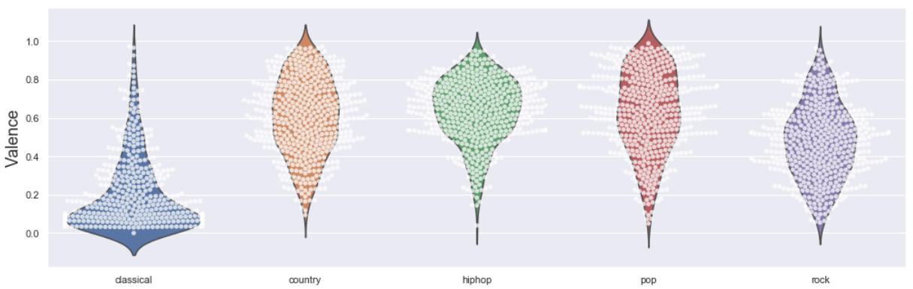
Feature Distributions based on Genre

Slide 14
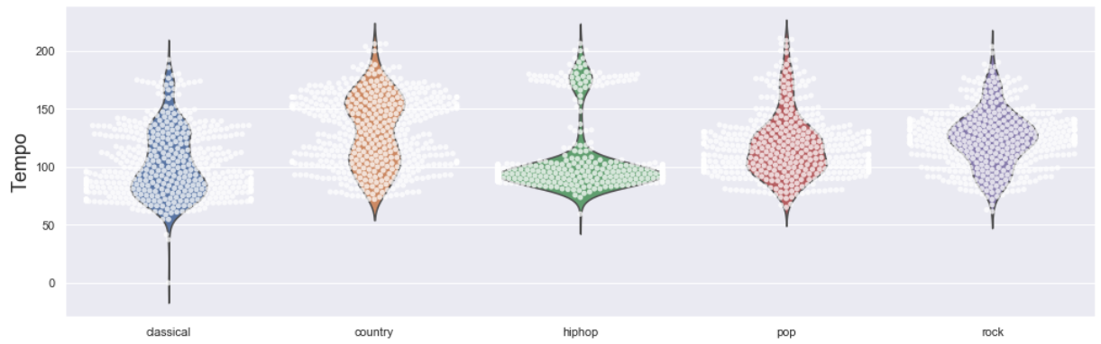
Feature Distributions based on Genre

Slide 15
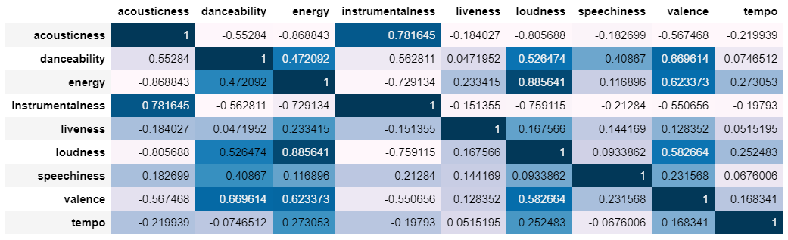
Correlation Matrix of the Features

Slide 16
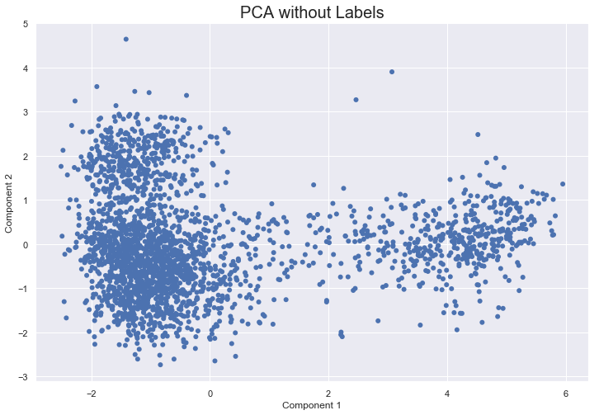

Slide 17
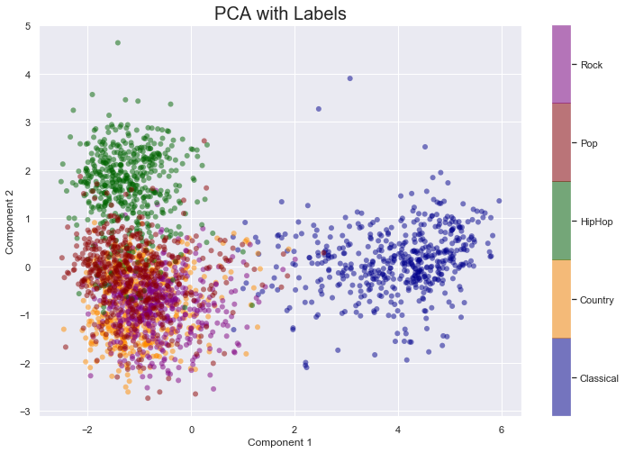

Slide 18
Table of Contents
Introduction
Data Exploration
In-depth Analysis and Modeling
Classifier
Results
Conclusions

Slide 19
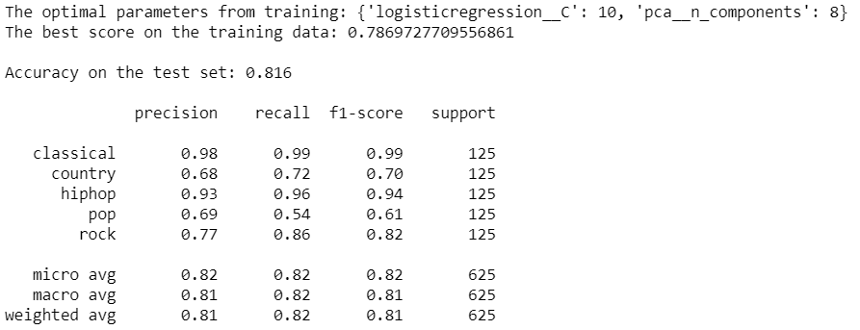

Slide 21
Table of Contents
Introduction
Data Exploration
In-depth Analysis and Modeling
Conclusions

